Slide 1
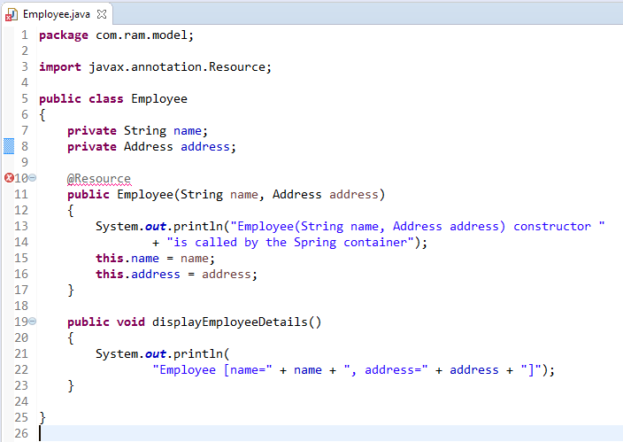

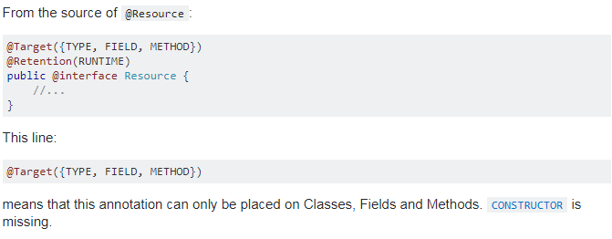
Spring Auto-Wiring Beans with @Resource annotation in Constructor
The @Resource annotation is auto wire the bean by matching name.
We can use @Resource annotation to auto wire bean on the setter method or a field. Here we have applied @Resource in Constructor and it is not possible.

